Slide 1
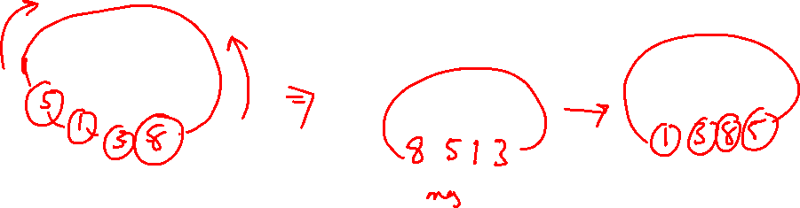
Pattern Recognition
Bayes Rule-Module 1

Slide 2
Contents
Probability
Bayes Decision Theory
Minimum Error Rate Classification

Slide 3
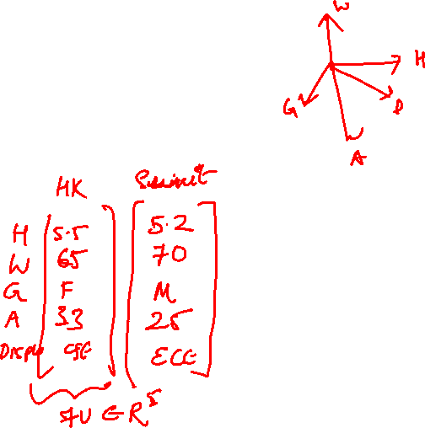
Last Class
Types of Learning
Features
Shape / boundary
Texture Features
Color/Intensity
We consider a Feature Vector for object description

Slide 4
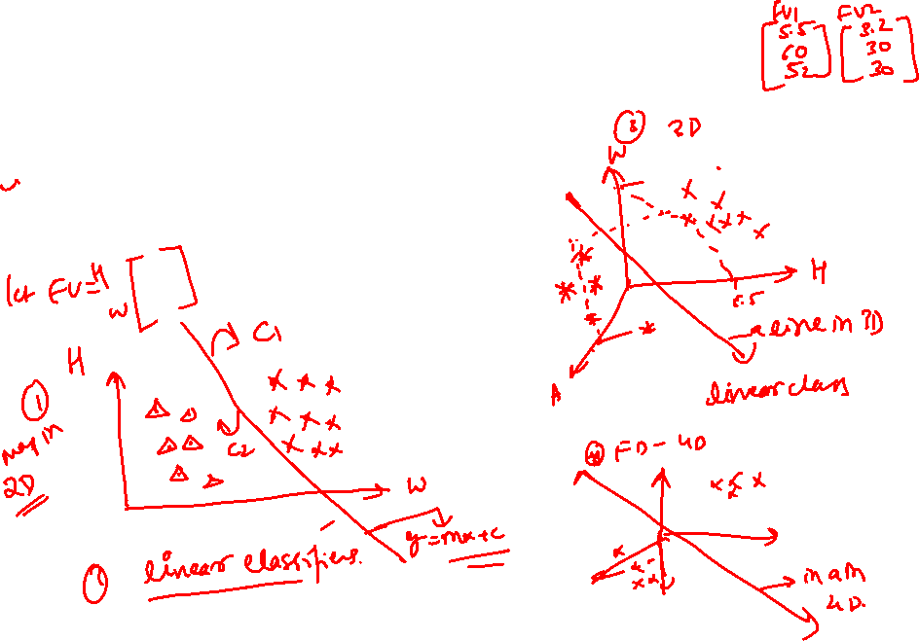
Decision Boundary (Linear)
FVs maps to points in feature space

Slide 5
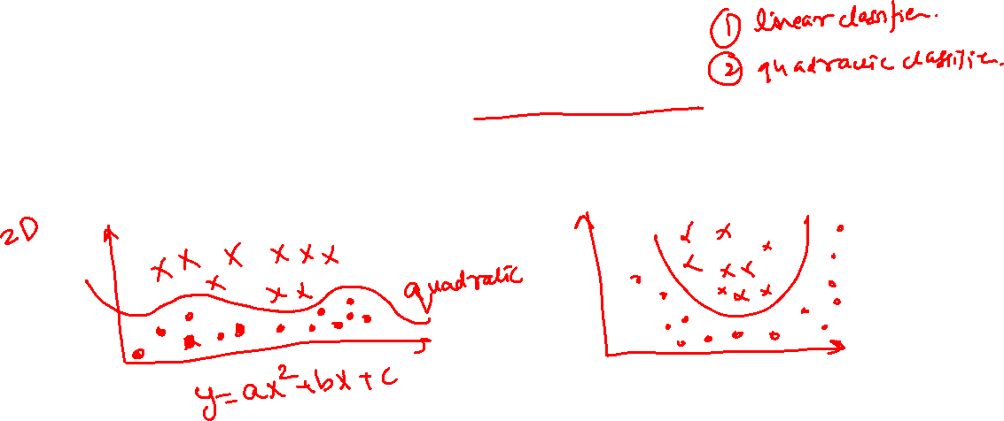
Decision Boundary (quadratic)
FVs maps to points in feature space

Slide 6
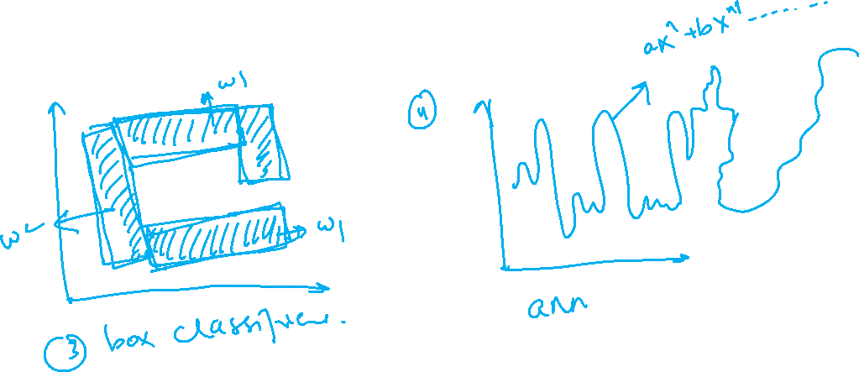
Decision Boundary (complicated)
FVs maps to points in feature space

Slide 7
Bayesian decision theory
It makes the assumption that the decision problem is posed in probabilistic terms, and that all of the relevant probability values are known.

Slide 8
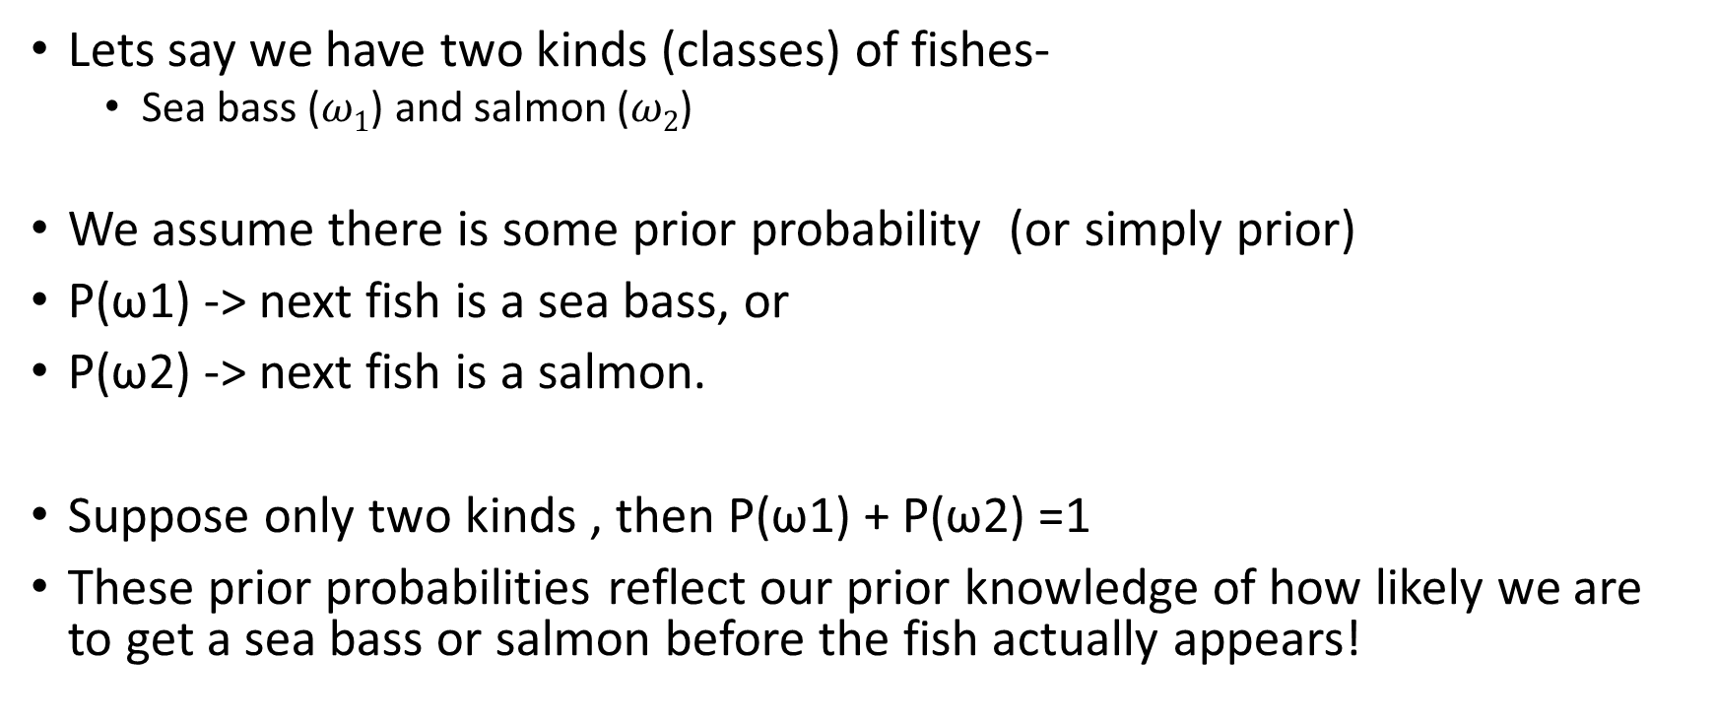
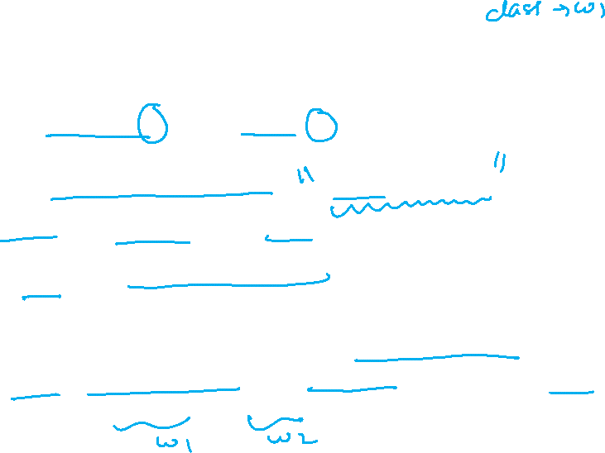
Notations and probability
Lets say we have two kinds (classes) of fishes-
Sea bass ($ω1$) and salmon ($ω2$)
We assume there is some prior probability (or simply prior)
P(ω1) -> next fish is a sea bass, or
P(ω2) -> next fish is a salmon.
Suppose only two kinds , then P(ω1) + P(ω2) =1
These prior probabilities reflect our prior knowledge of how likely we are to get a sea bass or salmon before the fish actually appears!

Slide 9

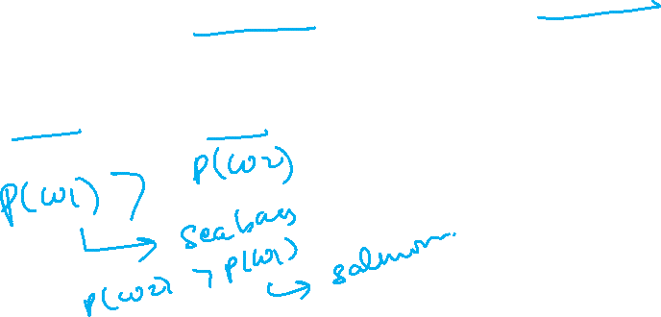
Notations and probability
And you are observing them coming on a conveyer belt:
Only prior probabilities are known:
i.e., P(ω1), and P(ω2)
What is the type of
fish that will appear next without being allowed to see it??
If P(ω1) > P(ω2) - > ω1, otherwise
If P(ω1) < P(ω2) - > ω2

Slide 10
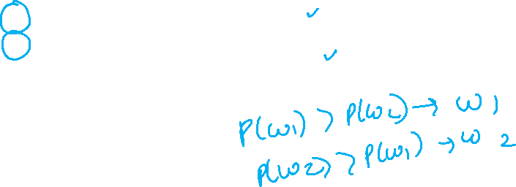
Notations and probability
Is this a good way to predict?
This rule makes sense if we are to judge just one fish, but if we are to judge many fish, using this rule repeatedly may seem a bit strange..
P(ω2) is very large as compared to P(ω1)….
Therefore predicting P(ω2) will be right most of the times
Class | Observation | Prior Probability
Sea bass | 10 | P(ω1)= 10 %
Salmon | 90 | P(ω2)= 90 %

Slide 11

Notations and probability
Is this a good way to predict?
This rule makes sense if we are to judge just one fish, but if we are to judge many fish, using this rule repeatedly may seem a bit strange..
P(ω2) is only bit large than P(ω1)….
Therefore predicting P(ω2) will be not be right most of the times, high chances of error!!!
Class | Observation | Prior Probability
Sea bass | 47 | P(ω1)= 47 %
Salmon | 53 | P(ω2)= 53 %

Slide 12
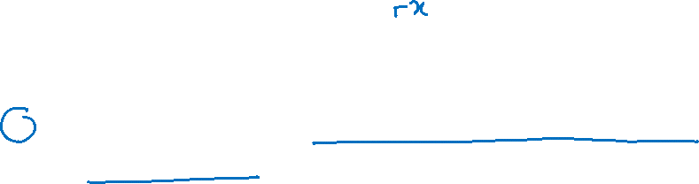

Notations and probability
We usually do not have only this little information
Lets say with each fish is associated a features with is weight
For example, heavy / light
we consider x to be a continuous random variable whose distribution depends on the state of nature (state represents class)

Slide 13
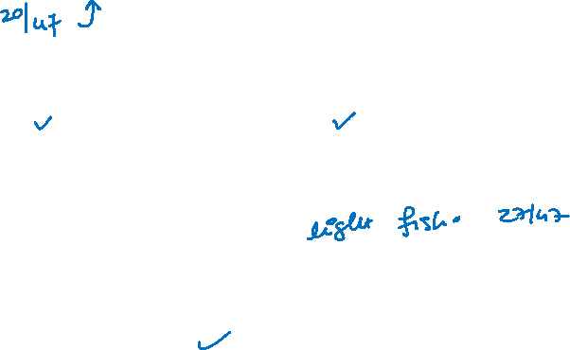

Notations and probability
So the probability for observing heavy, in this case, is approximately 42%.
In the same way, I can also compute the probability for light, which is approximately 68%.
Evidence | No. of Heavy | No. of Light | Total
Sea bass | 20 | 27 | 47
Salmon

Slide 14
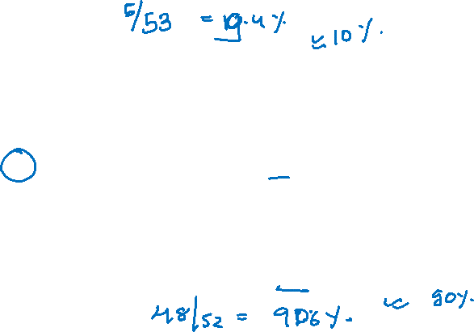

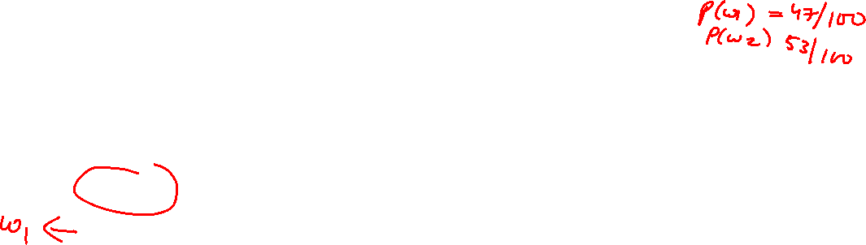
Notations and probability
So the probability for observing heavy, in this case, is approximately ……..
So the probability for observing light, in this case, is approximately ……..
Evidence | No. of Heavy | No. of Light | Total
Sea bass | 20 | 27 | 47
Salmon | 5 | 48 | 53

Slide 15
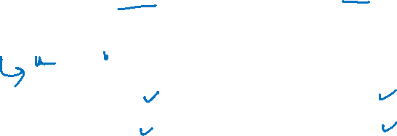
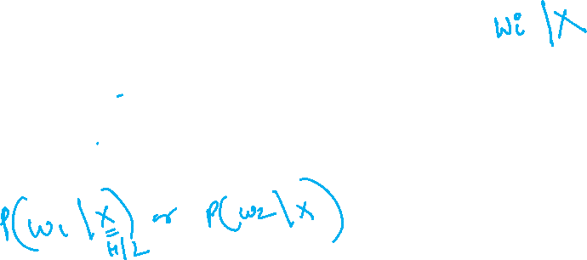
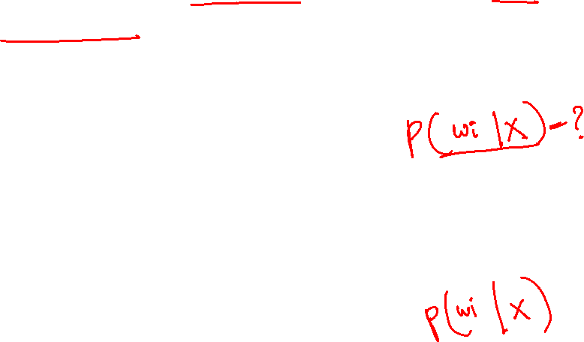

Notations and probability
Let’s say that the inspector is blind and can’t differentiate the classes by seeing.
So this is essentially the problem that we are facing. We can’t access the class, but there is some true class that is somehow hidden.
Evidence | No. of Heavy | No. of Light | Total
Sea bass | 20 | 27 | 47
Salmon | 8 | 45 | 53

Slide 16
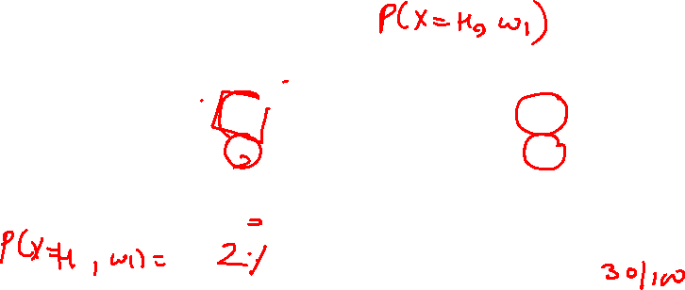
Notations and probability
Joint Probability
probability that you observe heavy and seabass at the same time
P(x= heavy, ω1 ) = 40%
Evidence | No. of Heavy | No. of Light | Total
Sea bass | 40 | 27 | 67
Salmon | 2 | 30 | 33
 | 42 | 57 | 100

Slide 17
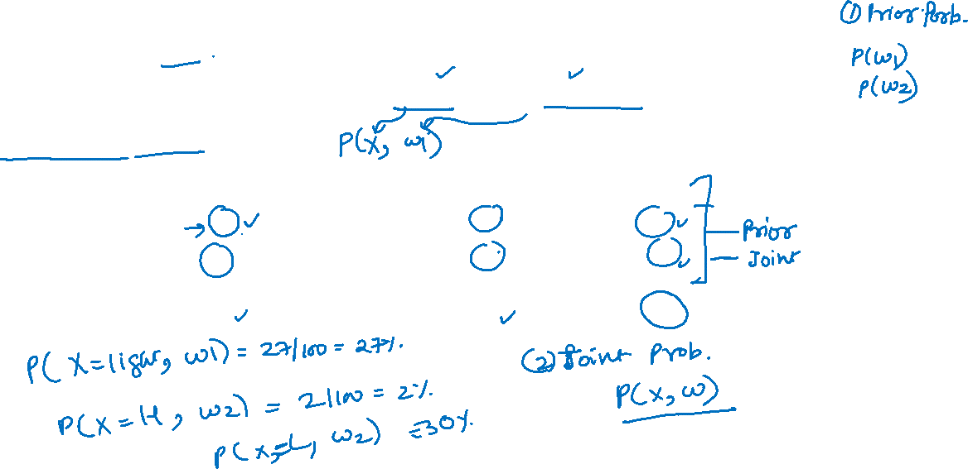
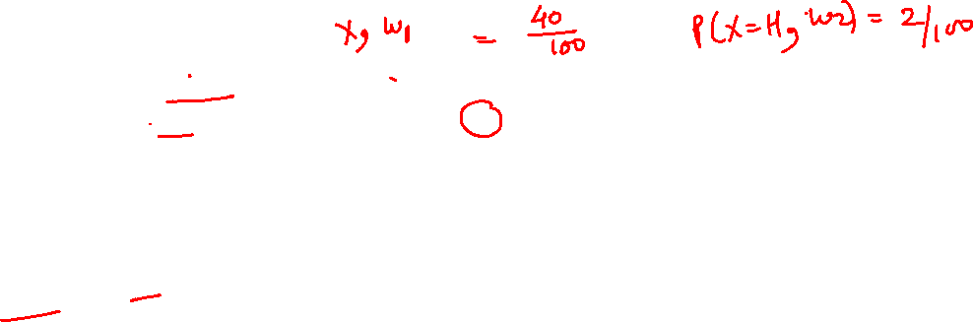
Notations and probability
Joint Probability
probability that you observe heavy and seabass at the same time
P(x= heavy, ω1 ) = 40%
Evidence | No. of Heavy | No. of Light | Total
Sea bass | 40 | 27 | 67
Salmon | 2 | 30 | 33
 | 42 | 57 | 100

Slide 18
Notations and probability
We can of course analyze our fishes here.
Here you see that salmon is the one that is biased towards light weight,
and you can compute the probability for heavy given the class is salmon
Evidence | No. of Heavy | No. of Light | Total
Sea bass | 40 | 27 | 67
Salmon | 2 | 30 | 33
 | 42 | 57 | 100

Slide 19
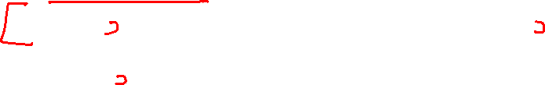
Notations and probability
I start exploring the bucket of salmon ,
I will only have a 5% chance of producing heavy,
and I will have a 96% chance of producing light.
Now, this is essentially the information that operator don’t have.
He get the observation heavy and light because the operator is blind.
Evidence | No. of Heavy | No. of Light | Total
Sea bass | 40 | 27 | 67
Salmon | 2 | 30 | 32
 | 42 | 57 | 100

Slide 20
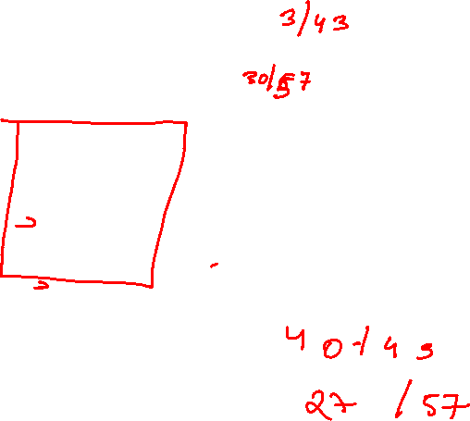
Notations and probability
Conditional Probability:
P(ω2=salmon| x=heavy ) =
P(ω2=salmon|x=light ) =
P(ω1=seabass| x=heavy ) =
P(ω1=seabass| x=light ) =
Evidence | No. of Heavy | No. of Light | Total
Sea bass | 40 | 27 | 67
Salmon | 2 | 30 | 33
 | 42 | 57 | 100

Slide 21
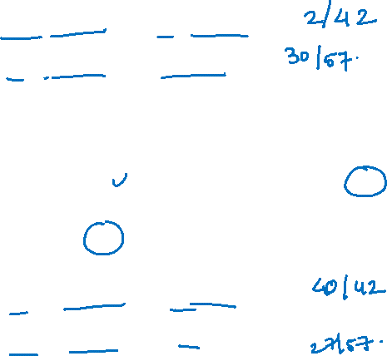
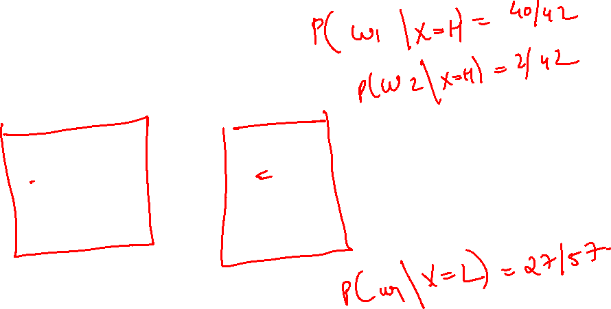
Notations and probability
Conditional Probability:
P(ω2=salmon| x=heavy ) =
P(ω2=salmon|x=light ) =
P(ω1=seabass| x=heavy ) =
P(ω1=seabass| x=light ) =
Evidence | No. of Heavy | No. of Light | Total
Sea bass | 40 | 27 | 67
Salmon | 2 | 30 | 33
 | 42 | 57 | 100

Slide 22

Notations and probability
And now I’m interested in figuring out whether it’s the fish is salmon or seabass by looking at the feature
Evidence | No. of Heavy | No. of Light | Total
Sea bass | 40 | 27 | 67
Salmon | 2 | 30 | 33
 | 42 | 57 | 100

Slide 23
Notations and probability
If I get a light fish, then
Chances of its being seabass is:
(27/57) =47%
Chance of being salmon is
Evidence | No. of Heavy | No. of Light | Total
Sea bass | 40 | 27 | 67
Salmon | 2 | 30 | 33
 | 42 | 57 | 100

Slide 24
Notations and probability
If I get a heavy fish, then
Chances of its being seabass is ( /42) = %
Chance of being salmon is
So observing heavy, in this case, is very strong evidence, that seabass is the underlying class
And you can already see this is a very typical Pattern Classification problem
Evidence | No. of Heavy | No. of Light | Total
Sea bass | 40 | 27 | 67
Salmon | 2 | 30 | 33
 | 42 | 57 | 100

Slide 25
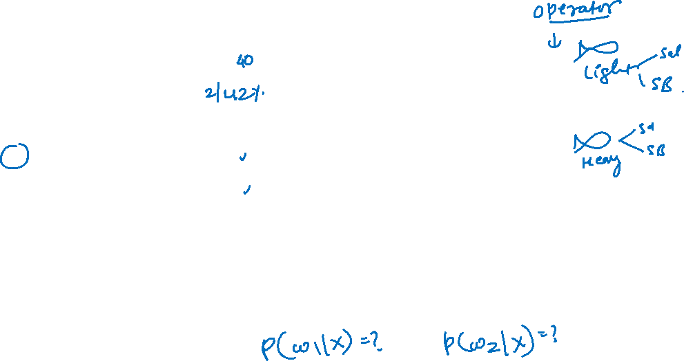
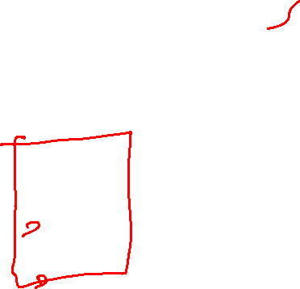
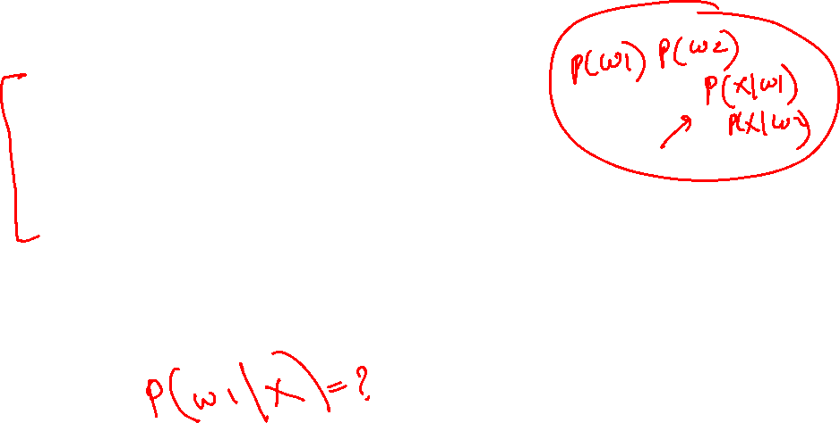
Notations and probability
If I get a heavy fish, then
Chances of its being seabass is ( /42) = %
Chance of being salmon is
So observing heavy, in this case, is very strong evidence, that seabass is the underlying class
And you can already see this is a very typical Pattern Classification problem
Evidence | No. of Heavy | No. of Light | Total
Sea bass | 40 | 27 | 67
Salmon | 2 | 30 | 33
 | 42 | 57 | 100

Slide 26
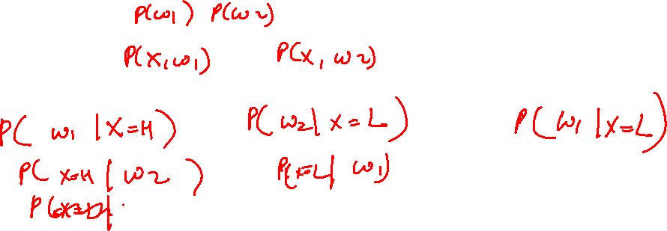

Notations and probability
Prior Probability
Joint Probability
Conditional Probability

Slide 27
Notations and probability
So we want to have some information about the the class from the observed evidence.
And you already see that it’s hard.
But if we have distributions like this one, then you can get very interesting and very good evidence from our experiments.

Slide 28
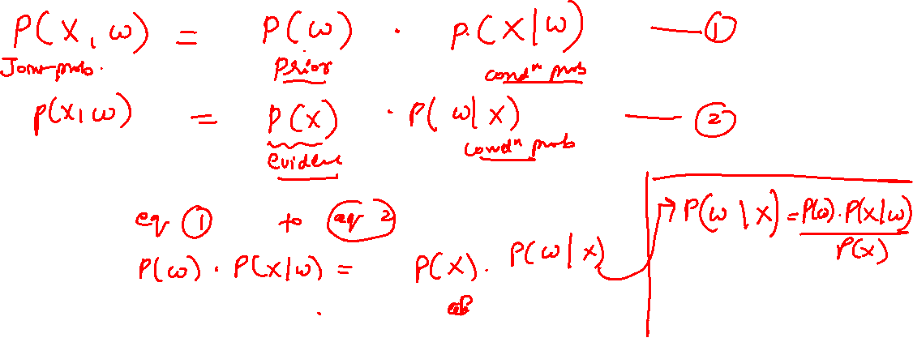
Bayes Rule

Slide 29
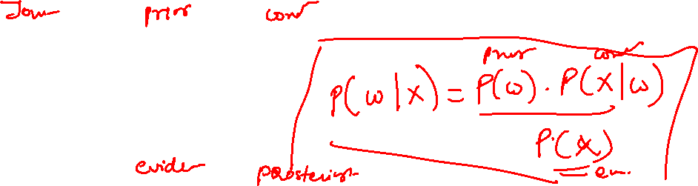
Bayes Rule
P(x, ω) = P (ω) . P(x|ω)
= P(x) . P(ω|x)

Slide 30
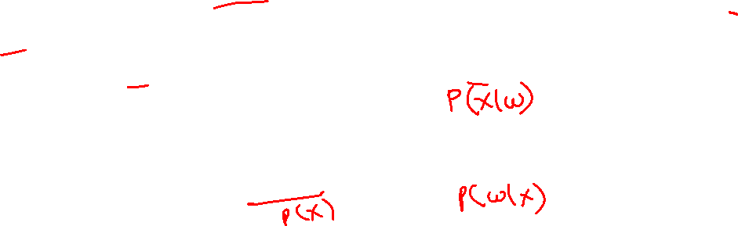

Bayes Rule
We’ve seen that the joint probability density function here with x and ω can be decomposed into the prior.
So the probability of having certain fish times the class conditional probability density function.
Obviously, the same joint pdf can be produced by using the probability of the evidence times the posterior probability.
So we can express the same joint probability density function using those two decompositions.

Slide 31
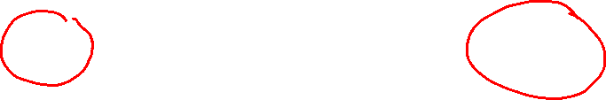
Bayes Rule
Let prior probabilities P(ωj) and the conditional densities p(x|ωj ) known.
Weight of a fish and discover that its value is x.
How does this measurement influence our attitude concerning the
true state of nature — that is, the category of the fish?

Slide 32
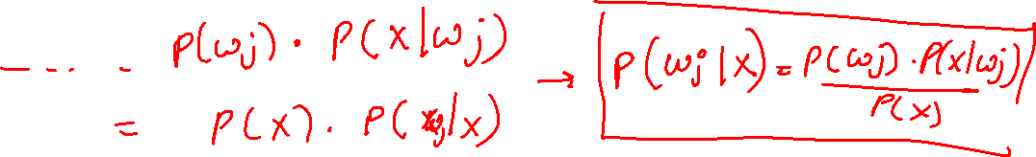
Bayes Rule
We note first that the (joint) probability density of finding a pattern that is in category ωj and has feature value x can be written two ways:
p(ωj, x) =

Slide 33
Bayes Rule
Rearranging these leads us to the answer to our question, which is called Bayes’ formula:

Slide 34

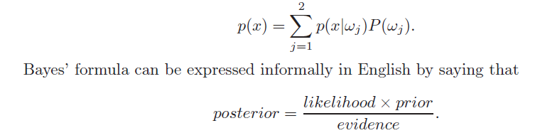
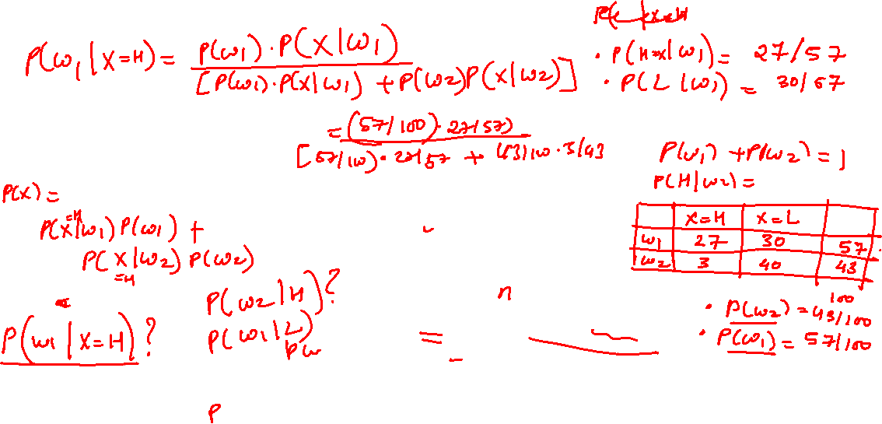
Bayes Rule
Rearranging these leads us to the answer to our question, which is called Bayes’ formula:
where

Slide 35
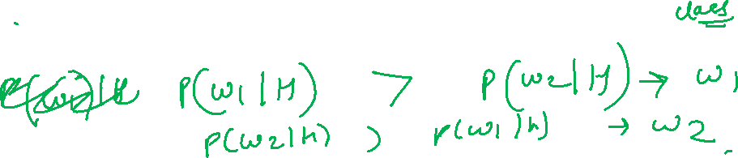

Notations and probability
Bayes’ formula shows that by observing the value of x we can convert the prior probability P(ωj) to the a posteriori probability (or posterior) probability P(ωj |x)
By knowing p(x|ωj) the likelihood of ωj with respect to x
Notice that it is the product of the likelihood and the prior probability that is most important in determining the posterior probability;
the evidence factor, p(x), can be viewed as merely a scale factor that guarantees that the posterior probabilities sum to one, as all good probabilities must.

Slide 36
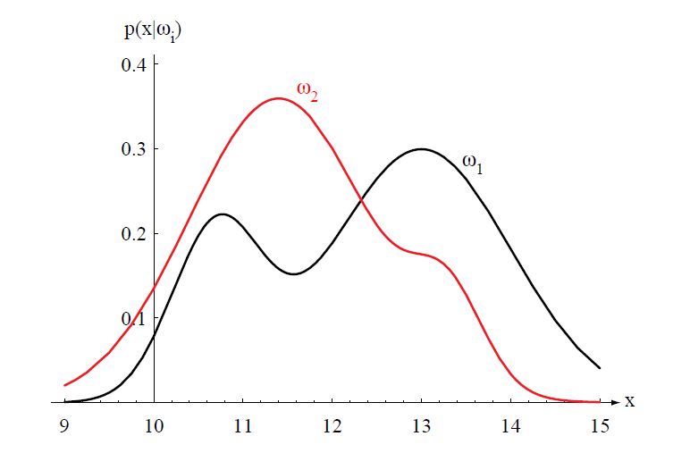
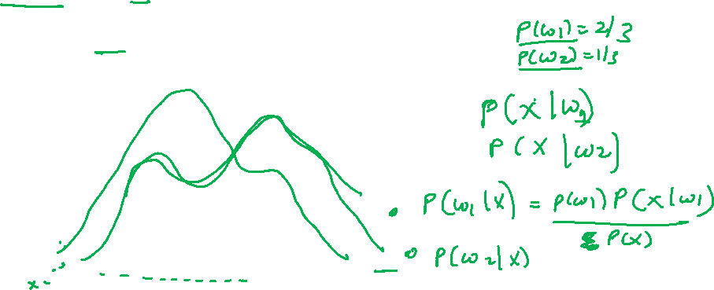
Bayes Rule
The variation of P(x|ωj) with x is illustrated in Fig. for the case P(ω1) = 2/3 and P(ω2) = 1/3.
Figure 2.1: Hypothetical class-conditional probability density functions show the probability density of measuring a particular feature value x given the pattern is in category ωi. If x represents the weight of a fish, the two curves might describe the difference in length of populations of two types of fish. Density functions are normalized, and thus the area under each curve is 1.0.

Slide 37
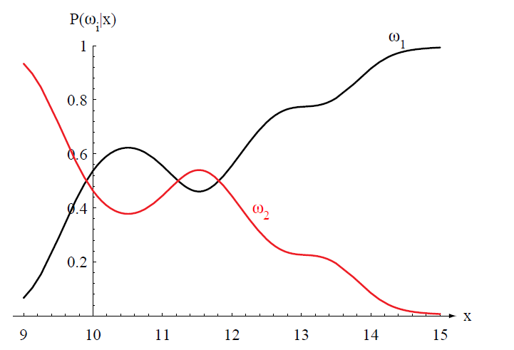
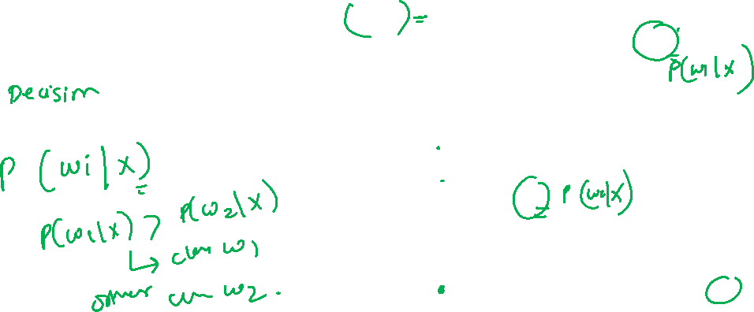
Bayes Rule
Posterior probabilities for the particular priors P(ω1) = 2/3 and P(ω2) =1/3 for the class-conditional probability densities shown in Fig. Thus in this case, given that a pattern is measured to have feature value x = 14, the probability it is in category ω2 is roughly 0.08, and that it is in ω1 is 0.92. At every x, the posteriors sum to 1.0.

Slide 38
Bayes Rule
Given two classes
If we have an observation x for which we estimate P(ω1|x) , P(ω2|x),

Slide 39
Bayes Rule
If we have an observation x for which P(ω1|x) is greater than P(ω2|x), we would naturally be inclined to decide that the true state of nature is ω1.
Similarly, if P(ω2|x) is greater than P(ω1|x), we would be inclined to choose ω2.
Probability of error?

Slide 40
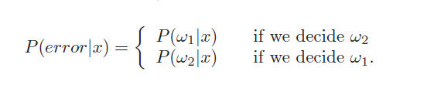
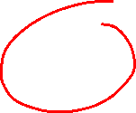
Bayes Rule
If we have an observation x for which P(ω1|x) is greater than P(ω2|x), we would naturally be inclined to decide that the true state of nature is ω1.
Similarly, if P(ω2|x) is greater than P(ω1|x), we would be inclined to choose ω2.
Probability of error?

Slide 41
Bayes Rule
Similarly, if P(ω2|x) is greater than P(ω1|x), we would be inclined to choose ω2.
Probability of error?
average probability of error is given by

Slide 42

Bayes Rule
Similarly, if P(ω2|x) is greater than P(ω1|x), we would be inclined to choose ω2.
Probability of error?
average probability of error is given by
and if for every x we insure that P(error|x) is as small as possible, then the integral must be as small as possible

Slide 43
Bayes Rule
Thus we have justified the following Bayes’ decision rule for minimizing the probability of error:
and under this rule error becomes
This form of the decision rule emphasizes the role of the posterior probabilities.

Slide 44
Bayes Rule
We know how to express P(ωj|x)
We know
note that the evidence, p(x), becomes unimportant as far as making a decision is concerned. Its just a scale factor
Also P(ω1|x) + P(ω2|x) = 1.
We obtain the following completely equivalent decision rule

Slide 45
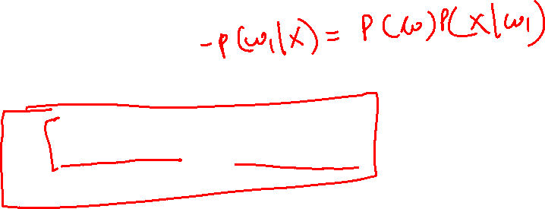
Bayes Rule
We know how to express P(ωj|x)
We know
note that the evidence, p(x), becomes unimportant as far as making a decision is concerned. Its just a scale factor
Also P(ω1|x) + P(ω2|x) = 1.
We obtain the following completely equivalent decision rule:

Slide 46
Bayes rule
Some additional insight can be obtained by considering a few special cases.
If for some x we have p(x|ω1) = p(x|ω2), then that particular observation gives us no information about the state of nature.
On the other hand, if P(ω1) = P(ω2), then the states of nature are equally probable;
In general, both of these factors are important in making a decision, and the Bayes decision rule combines them to achieve the minimum probability of error.

Slide 47
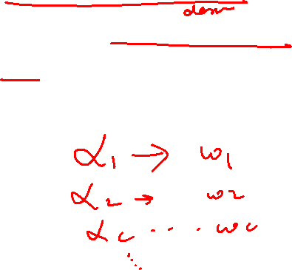
Bayesian Decision Theory – Continuous Features
We shall now formalize the ideas just considered, and generalize them in four ways:
by allowing the use of more than one feature
by allowing more than two states of nature
by allowing actions other than merely deciding the state of nature
by introducing a loss function more general than the probability of error.

Slide 48
Bayesian Decision Theory
Let ω1, ..., ωc be the finite set of c states of nature (“categories”)
Let α1, ..., αa be the finite set of a possible actions.

Slide 49
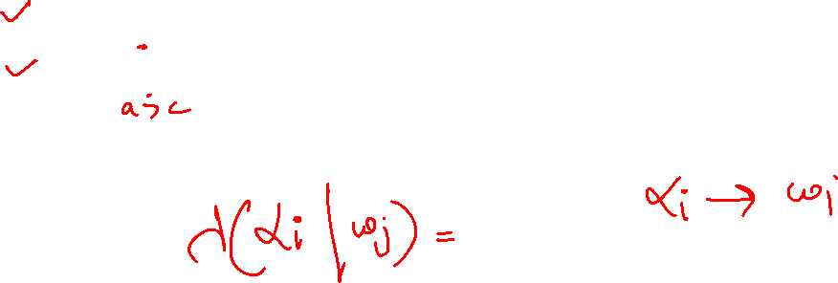
Bayesian Decision Theory
Let ω1, ..., ωc be the finite set of c states of nature (“categories”)
Let α1, ..., αa be the finite set of a possible actions.
The loss function λ(αi|ωj) describes the loss incurred for taking action αi when the state of nature is ωj .

Slide 50
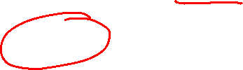
Bayesian Decision Theory
Let ω1, ..., ωc be the finite set of c states of nature (“categories”)
Let α1, ..., αa be the finite set of a possible actions.
The loss function λ(αi|ωj) describes the loss incurred for taking action αi when the state of nature is ωj .
Let the feature vector x be a d-component vector-valued random variable,
and let p(x|ωj) be the state conditional probability density function for x — the probability density function for x conditioned on ωj being the true state of nature.

Slide 51
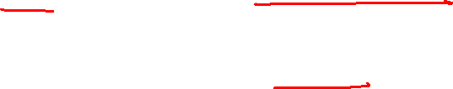
Bayesian Decision Theory
As before, P(ωj) describes the prior probability that nature is in state ωj .
Then the posterior probability P(ωj |x) can be computed from p(x|ωj) by Bayes’ formula:

Slide 52
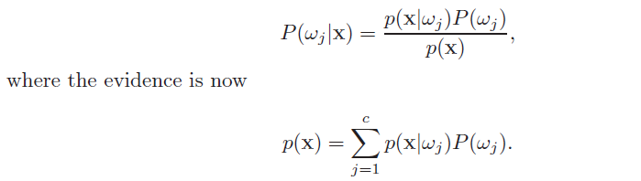
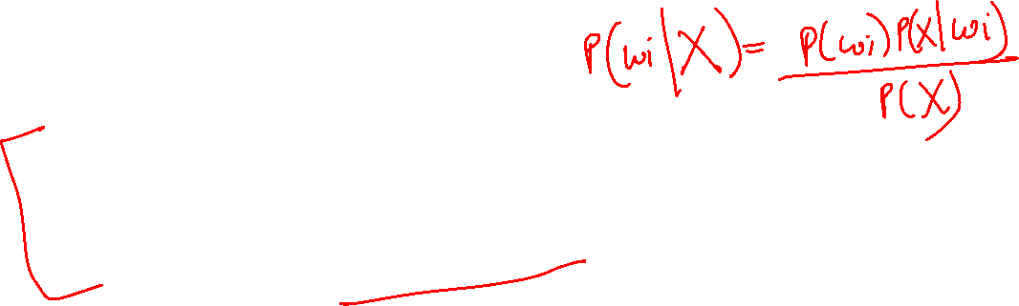
Bayesian Decision Theory
As before, P(ωj) describes the prior probability that nature is in state ωj .
Then the posterior probability P(ωj |x) can be computed from p(x|ωj) by Bayes’ formula:

Slide 53

Bayesian Decision Theory
Suppose that we observe a particular x and that we contemplate taking action αi.
If the true state of nature is ωj , by definition we will incur the loss λ(αi|ωj ).
Since P(ωj |x) is the probability that the true state of nature is ωj , the expected loss associated with taking action αi is merely

Slide 54
Bayesian Decision Theory
Suppose that we observe a particular x and that we contemplate taking action αi.
If the true state of nature is ωj , by definition we will incur the loss λ(αi|ωj ).
Since P(ωj |x) is the probability that the true state of nature is ωj , the expected loss associated with taking action αi is merely

Slide 55
Bayesian Decision Theory
Suppose that we observe a particular x and that we contemplate taking action αi.
If the true state of nature is ωj , by definition we will incur the loss λ(αi|ωj ).
Since P(ωj |x) is the probability that the true state of nature is ωj , the expected loss associated with taking action αi is merely

Slide 56
Bayesian Decision Theory
RISK
In decision-theoretic terminology, an expected loss is called a risk, and R(αi |x) is called the conditional risk.
Whenever we encounter a particular observation x, we can minimize our expected loss by selecting the action that minimizes the conditional risk.
We shall now show that this Bayes decision procedure actually provides the optimal performance on an overall risk

Slide 57
Bayesian Decision Theory
Our problem : find a decision rule against P(ωj) that minimizes the overall risk.
A general decision rule is a function α(x) that tells us which rule action to take for every possible observation.
Every x the decision function α(x) assumes one of the a values α1, ..., αa.
The overall risk R is the expected loss associated with a given decision rule.
Since R(αi|x) is the conditional risk associated with action αi, and since the decision rule specifies the action, the overall risk is given by

Slide 58

Bayesian Decision Theory
Our problem : find a decision rule against P(ωj) that minimizes the overall risk.
A general decision rule is a function α(x) that tells us which rule action to take for every possible observation.
Every x the decision function α(x) assumes one of the a values α1, ..., αa.
The overall risk R is the expected loss associated with a given decision rule.
Since R(αi|x) is the conditional risk associated with action αi, and since the decision rule specifies the action, the overall risk is given by

Slide 59

Bayesian Decision Theory
Bayes decision rule: To minimize the overall risk, compute the conditional risk
for i = 1,...,a and select the action αi for which R(αi|x) is minimum.
The resulting minimum overall risk is called the Bayes risk.

Slide 60
Bayesian Decision Theory
Two-Category Classification Problem
Here action α1 corresponds to deciding that the true state of nature is ω1, and action α2 corresponds to deciding that it is ω2.
For notational simplicity, let λij = λ(αi|ωj) be the loss incurred for deciding ωi when the true state of nature is ωj .
conditional risk given is

Slide 61
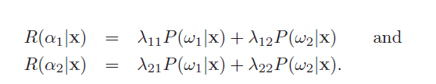
Bayesian Decision Theory
Two-Category Classification Problem
Here action α1 corresponds to deciding that the true state of nature is ω1, and action α2 corresponds to deciding that it is ω2.
For notational simplicity, let λij = λ(αi|ωj) be the loss incurred for deciding ωi when the true state of nature is ωj .
conditional risk given is

Slide 62

Bayesian Decision Theory
Two-Category Classification Problem
Here action α1 corresponds to deciding that the true state of nature is ω1, and action α2 corresponds to deciding that it is ω2.
For notational simplicity, let λij = λ(αi|ωj) be the loss incurred for deciding ωi when the true state of nature is ωj .
conditional risk given is

Slide 63

Bayesian Decision Theory
There are a variety of ways of expressing the minimum-risk decision rule, each having its own minor advantages.
The fundamental rule is to decide ω1 if R(α1|x) < R(α2|x).
In terms of the posterior probabilities, we decide ω1 if

Slide 64

Bayes Decision Theory
By employing Bayes’ formula, we can replace the posterior probabilities by the prior probabilities and the conditional densities.
This results in the equivalent rule, to decide ω1 if

Slide 65
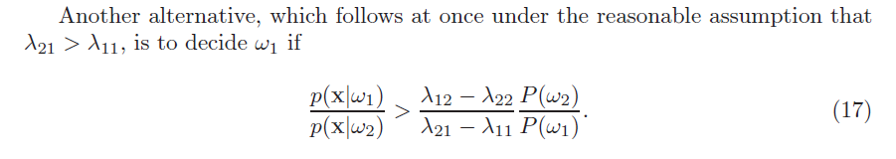

Bayesian Decision Theory
We can consider p(x|ωj) a function of ωj (i.e., the likelihood function),
then likelihood ratio is p(x|ω1)/p(x|ω2).
Thus the Bayes decision rule can be interpreted ratio as calling for deciding ω1 if the likelihood ratio exceeds a threshold value that is independent of the observation x.

Slide 66


Bayes Decision Theory
The likelihood ratio

Slide 67
Minimum-Error-Rate Classification

Slide 68
Minimum-Error-Rate Classification
Given ‘c’ classes
Action αi is usually interpreted as the decision that the true state of nature is ωi. (predicted class).
If action αi is taken and the true state of nature is ωj , then
the decision is correct if i = j, and in error if i != j.
Then so-called symmetrical or zero-one loss function can be defined as:

Slide 69

Minimum-Error-Rate Classification
Given ‘c’ classes
Action αi is usually interpreted as the decision that the true state of nature is ωi. (predicted class).
If action αi is taken and the true state of nature is ωj , then
the decision is correct if i = j, and in error if i != j.
Then so-called symmetrical or zero-one loss function can be defined as:

Slide 70
Minimum-Error-Rate Classification
Given ‘c’ classes
Action αi is usually interpreted as the decision that the true state of nature is ωi. (predicted class).
If action αi is taken and the true state of nature is ωj , then
the decision is correct if i = j, and in error if i != j.
Then so-called symmetrical or zero-one loss function can be defined as:

Slide 71
Minimum-Error-Rate Classification
Given ‘c’ classes
Action αi is usually interpreted as the decision that the true state of nature is ωi. (predicted class).
If action αi is taken and the true state of nature is ωj , then
the decision is correct if i = j, and in error if i != j.
Then so-called symmetrical or zero-one loss function can be defined as:

Slide 72


Minimum-Error-Rate Classification
Bayes decision rule : minimize risk calls for selecting the action that minimizes the conditional risk.
Thus, to minimize the average probability of error, we should select the i that maximizes the posterior probability P(ωi|x).
In other words, for minimum error rate

